Slide 1

Computer Networks
Data Link Layer

Slide 2

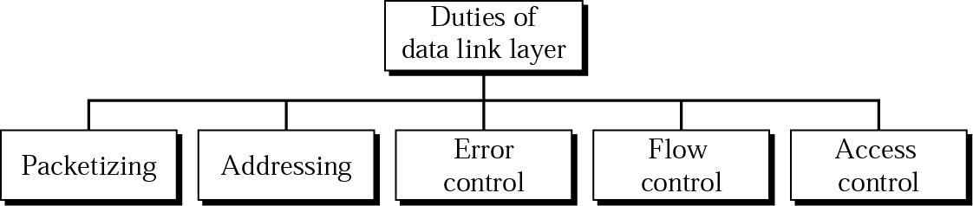
Position of the data-link layer

Slide 3
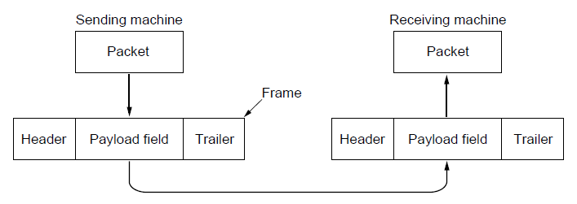
Data Link Layer Design Issues
Physical layer delivers bits of information to and from data link layer. The functions of Data Link Layer are:
  Takes the packets from Network layer, and
  Encapsulates them into frames
Each frame has a
  frame header – a field for holding the packet, and
  frame trailer.
Deals with transmission errors(Error Control).
Regulating the flow of data so that slow receivers are not swamped by fast senders(Flow control).

Slide 4
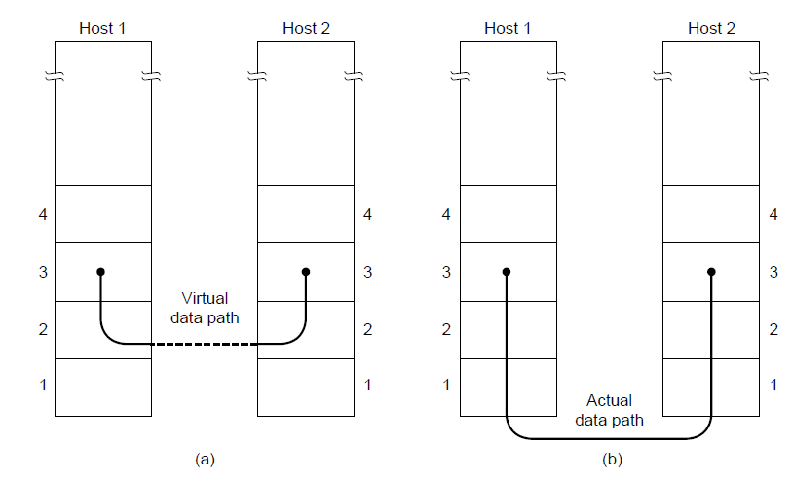
Services Provided to the Network Layer
Principal Service Function of the data link layer is to transfer the data from the network layer on the source machine to the network layer on the destination machine.
  Process in the network layer that hands some bits to the data link layer for transmission.
  Job of data link layer is to transmit the bits to the destination machine so they can be handed over to the network layer there (see figure below).

Slide 5
Possible Services Offered
Unacknowledged connectionless service.
Acknowledged connectionless service.
Acknowledged connection-oriented service.

Slide 6
Unacknowledged Connectionless Service
Receiver does not return acknowledgments to the sender.
  Sender has no way of knowing if a frame has been successfully delivered.
It consists of having the source machine sending independent frames to the destination machine without having the destination machine acknowledge them.
Example: Ethernet, Voice over IP, etc. in all the communication channel were real time operation is more important that quality of transmission.

Slide 7
Acknowledged Connectionless Service
Each frame send by the Data Link layer is acknowledged and the sender knows if a specific frame has been received or lost.
Typically the protocol uses a specific time period that if the given time has passed without getting acknowledgment it will re-send the frame.
This service is useful when an unreliable channel is being utilized (e.g., 802.11 WiFi).

Slide 8
Acknowledged Connection Oriented Service
Source and Destination establish a connection first.
Each frame sent is numbered
  Data link layer guarantees that each frame sent is indeed received.
  It guarantees that each frame is received only once and that all frames are received in the correct order.
Examples:
  Satellite channel communication
  Long-distance telephone communication, etc.

Slide 9
Framing
At sender : DLL translates the physical layer's raw bit stream into discrete units (messages) called frames.
At receiver : How can frame be transmitted so the receiver can detect frame boundaries? In other words, how can the receiver recognize the start and end of a frame?
    Byte Count
    Flag byte with Byte Stuffing
    Flag bits with bit stuffing
    Encoding Violations

Slide 10
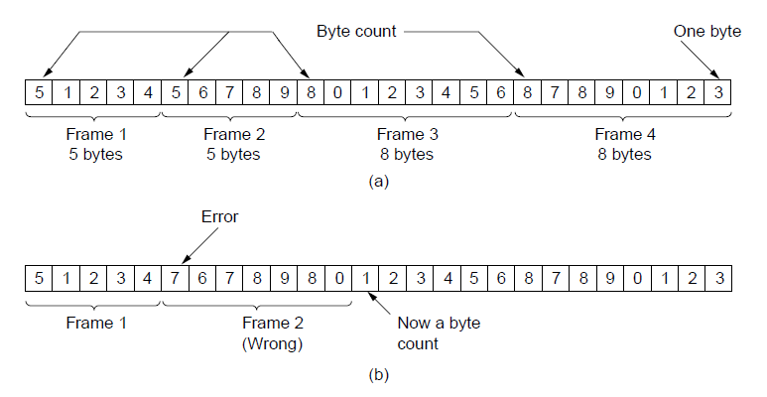
Byte Count Framing Method
It uses a field in the header to specify the number of bytes in the frame.
Once the header information is being received it will be used to determine end of the frame.
Trouble with this algorithm is that when the count is incorrectly received the destination will get out of synch with transmission.
  Destination may be able to detect that the frame is in error but it does not have a means (in this algorithm) how to correct it.

Slide 11
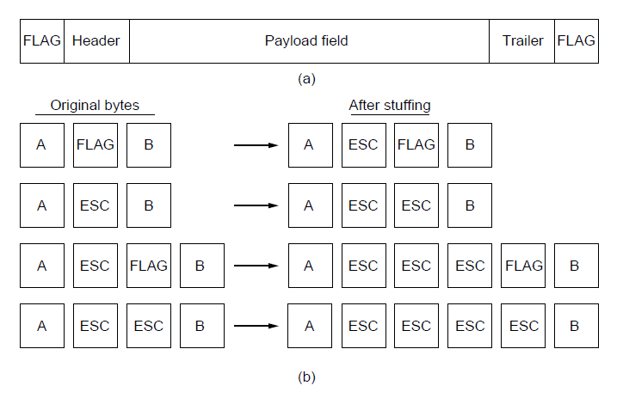
Flag Bytes with Byte Stuffing Framing
This method gets around the boundary detection of the frame by having each appended by the frame start and frame end special bytes.
If they are the same (beginning and ending byte in the frame) they are called flag byte.
If the actual data contains a byte that is identical to the FLAG(can happen with audio or photos) byte then the convention that can be used is to have escape character inserted just before the “FLAG” character.

Slide 12
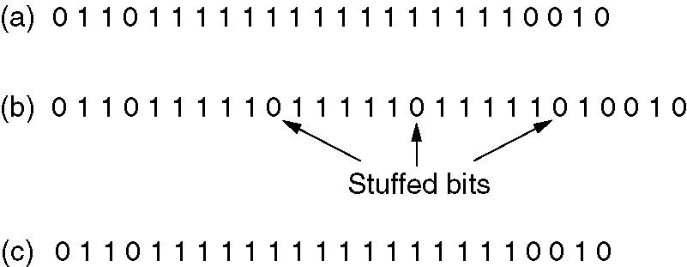
Flag Bits with Bit Stuffing
Starting and ending flag with bit stuffing
  Each frame begin and end with a special bite pattern (Flag) like 01111110 (0x7E)
  Whenever the sender DLL encounter 5 consecutive 1s in the data(Flag within the data), a 0 bit stuffs into outgoing stream.
  If user’s data contain flag 01111110 it transmitted as 011111010
 The original data.
 Data as appear on the line.
Receiver’s memory after destuffing.

Slide 13
Physical Layer Coding Violations
In this, no redundancy bytes are added at the start/end of the frame.
We are having some reserved signals(at physical layer) to indicate start and end of the frame.
Reserved signal will be transmitted before and after sending the data frame.

Slide 14
Error Detection
Networks must be able to transfer data from one device to another with complete accuracy.
Data can be corrupted during transmission.
For reliable communication, errors must be detected and corrected.
Error detection and correction are implemented either at the data link layer or the transport layer.
How to detect errors
  If only data is transmitted, errors cannot be detected.
    Send more information with data that satisfies a special relationship.
    Add redundancy.

Slide 15
Types of Errors
Single Bit Error
Burst Error

Slide 16
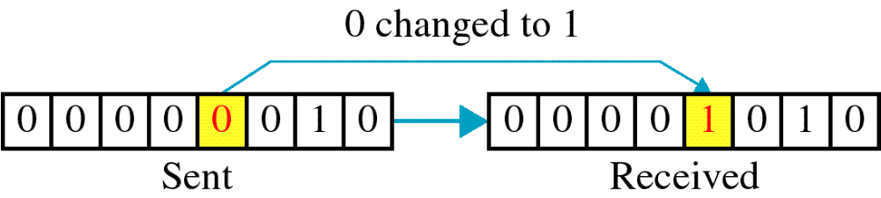
Single-bit error

Slide 17
Single bit errors are the least likely type of errors in serial data transmission because the noise must have a very short duration which is very rare.
Example:
If data is sent at 1Mbps then each bit lasts only 1/1,000,000 sec. or 1 μs.
For a single-bit error to occur, the noise must have a duration of only 1 μs, which is very rare.

Slide 18
The term burst error means that two or more bits in the data unit have changed from 1 to 0 or from 0 to 1.
Burst errors does not necessarily mean that the errors occur in consecutive bits, the length of the burst is measured from the first corrupted bit to the last corrupted bit. Some bits in between may not have been corrupted.

Slide 19
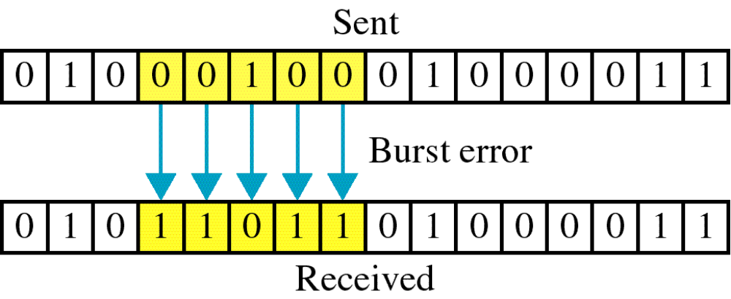
Burst error

Slide 20
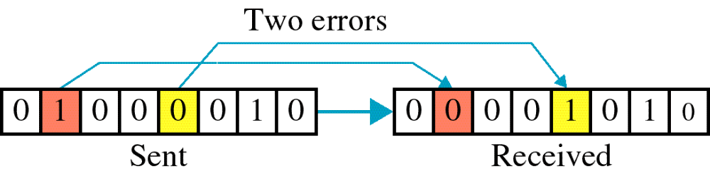
The length of the burst is measured from the first corrupted bit to the last corrupted bit.
Some bits in between may not have been corrupted.

Slide 21
Burst error is most likely to happen in serial transmission since the duration of noise is normally longer than the duration of a bit.
The number of bits affected depends on the data rate and duration of noise.
Example:
If data is sent at rate = 1Kbps then a noise of 1/100 sec can affect 10 bits.(1/100*1000)
If same data is sent at rate = 1Mbps then a noise of 1/100 sec can affect 10,000 bits.(1/100*10⁶)

Slide 22
Error detection
Error detection is to decide whether the received data is correct or not without having a copy of the original message.
Error detection uses the concept of redundancy, which means adding extra bits for detecting errors at the destination.
Notes:
Make sense of message.
Make sense of message.

Slide 23
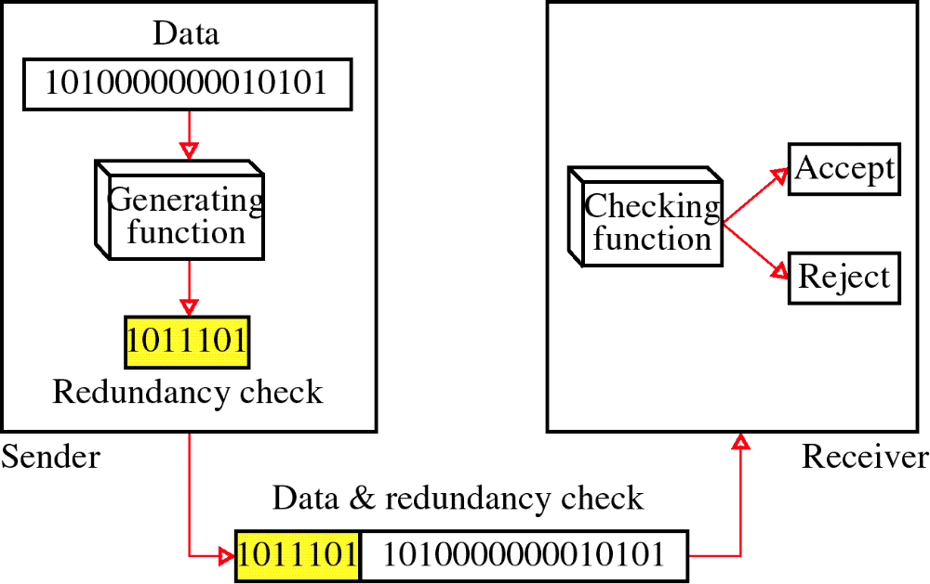
Redundancy

Slide 24
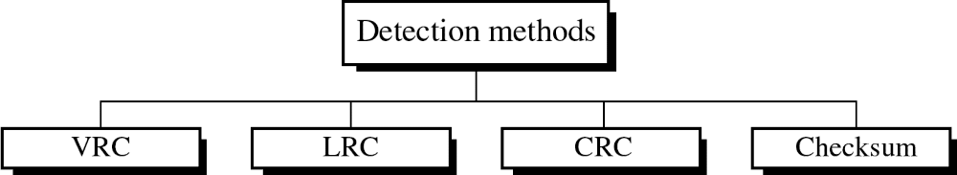
Four types of redundancy checks are used
in data communications

Slide 25
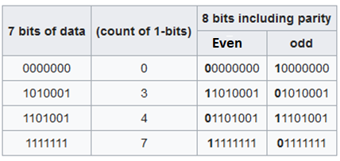
Error Detection Methods
Vertical Redundancy Check (VRC)
  Append a single bit at the end of data block based on Even parity or odd parity
    Even Parity : Count the occurrence of 1 in the given data
    0110011 → 01100110 (If number of 1’s are Even)
    0110001 → 01100011 (If number of 1’s are odd)
    Odd Parity : Count the occurrence of 1 in the given data
    0110011 → 01100111 (If number of 1’s are Even)
    0110001 → 01100010 (If number of 1’s are odd)

Slide 26
Performance
It can detect single bit error
It can detect burst errors only if the total number of errors is odd.

Slide 27
Longitudinal Redundancy Check
LRC
11100111 11011101 00111001 10101001
11100111
11011101
00111001
10101001
10101010
11100111 11011101 00111001 10101001 10101010
Original Data
LRC

Slide 28
Performance
LCR increases the likelihood of detecting burst errors.
If two bits in one data units are damaged and two bits in exactly the same positions in another data unit are also damaged, the LRC checker will not detect an error.

Slide 29
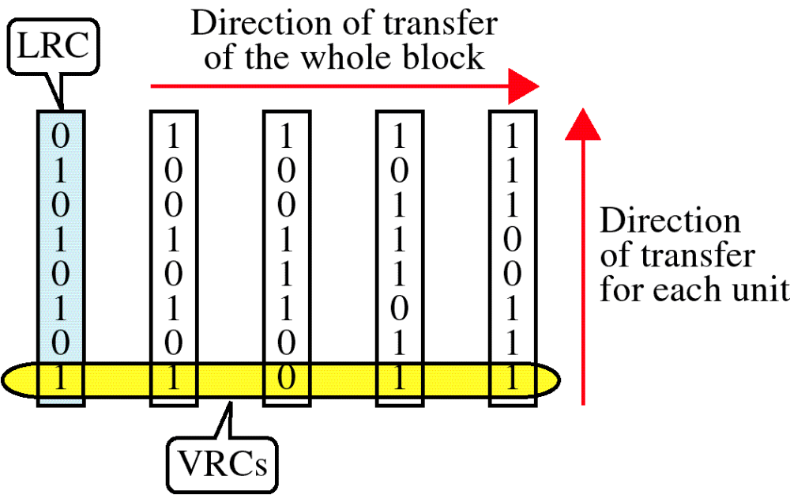
VRC and LRC

Slide 30
Cyclic Redundancy Check
Given a k-bit frame or message, the transmitter generates an n-bit sequence, known as a frame check sequence (FCS), so that the resulting frame, consisting of (k+n) bits, is exactly divisible by some predetermined number.
The receiver then divides the incoming frame by the same number and, if there is no remainder, assumes that there was no error.

Slide 31

Division in CRC encoder

Slide 32

Division in the CRC decoder for two cases

Slide 33
Checksum
Error Detection mechanism by adding all the databits
For example, if the set of numbers is (7, 11, 12, 0, 6), we send (7, 11, 12, 0, 6, 36), where 36 is the sum of the original numbers.
The receiver adds the five numbers and compares the result with the sum.
If the two are same, the receiver assumes no error (discard sum)
If the two are different, the receiver discard whole data.

Slide 34
Checksum
It is easy for the receiver to check with the negative value of the sum.
In this case, we send (7, 11, 12, 0, 6, −36).
The receiver can add all the numbers received (including the checksum).
If the result is 0, it assumes no error; otherwise, there is an error.

Slide 35
Internet Checksum (3)
Sending:
Arrange data in 16-bit words
Put zero in checksum position, add
Add any carryover back to get 16 bits
Negate (complement) to get sum
0001
f203
f4f5
f6f7
+(0000)
------
2ddf0
ddf0
+ 2
------
ddf2
220d

Slide 36
Internet Checksum (4)
Receiving:
Arrange data in 16-bit words
Checksum will be non-zero, add
Add any carryover back to get 16 bits
Negate the result and check it is 0
0001
f203
f4f5
f6f7
+ 220d
------
2fffd
fffd
+ 2
------
ffff
0000
Notes:
Work through example

Slide 37
Internet Checksum (5)
Receiving:
Arrange data in 16-bit words
Checksum will be non-zero, add
Add any carryover back to get 16 bits
Negate the result and check it is 0
0001
f203
f4f5
f6f7
+ 220d
------
2fffd
fffd
+ 2
------
ffff
0000

Slide 38
Error Correction
Once detected, the errors must be corrected
Two Techniques for error correction
  Retransmission (aka Backward error correction)
    Simplest, effective and most commonly used technique –
involves correction by retransmission of data by the sender
    Popularly called Automatic Repeat Request (ARQ)
  Forward Error Correction (FEC)
    Receiving device can correct the errors itself

Slide 39
Single-bit error correction
Hamming Codes
To correct an error, the receiver reverses the value of the altered bit. To do so, it must know which bit is in error.
Number of redundancy bits needed.
Let data bits = m
Redundancy bits = r
∴Total message sent = m+r
The value of r must satisfy the following relation to detect the location of the error:
2^{r} ≥ m+r+1

Slide 40
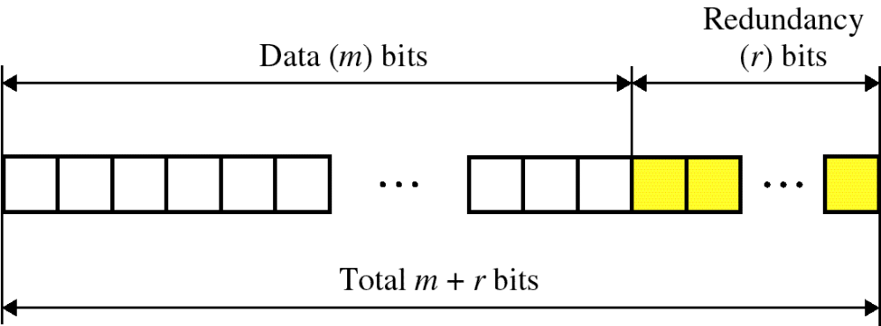
Error Correction- Hamming Code

Slide 41
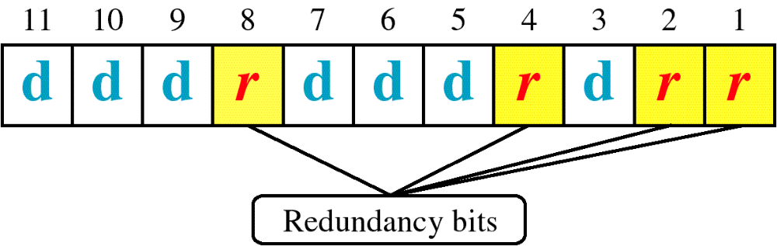
A Layout of Data and Check Bits that Achieves Our Design Criteria:
Bit position
11
10
9
8
7
6
5
4
3
2
1
Bit number
1011
1010
1001
1000
0111
0110
0101
0100
0011
0010
0001
Data bit
D7
D6
D5
D4
D3
D2
D1
Redundancy bit
r8
r4
r2
r1
2³
2²
2¹
2⁰

Slide 42
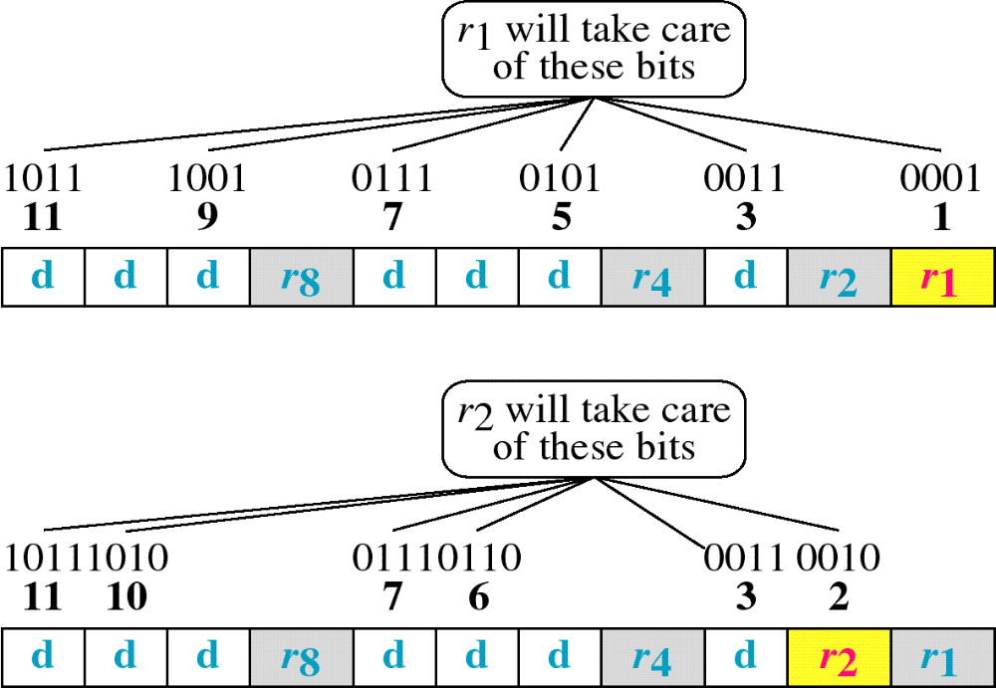
Hamming Code
r1 is a parity check on every data bit whose position is xxx1
r2 is a parity check on every data bit whose position is xx1x

Slide 43
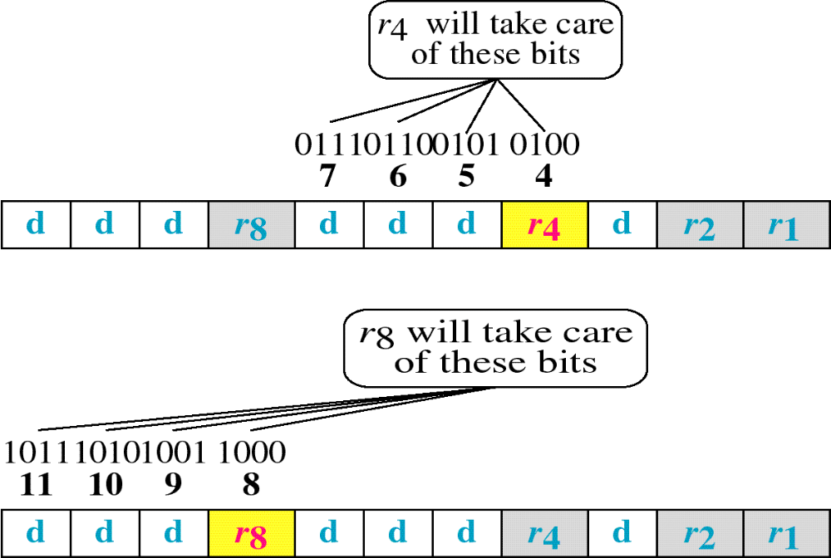
Hamming Code
r4 is a parity check on every data bit whose position is x1xx
r8 is a parity check on every data bit whose position is 1xxx

Slide 44
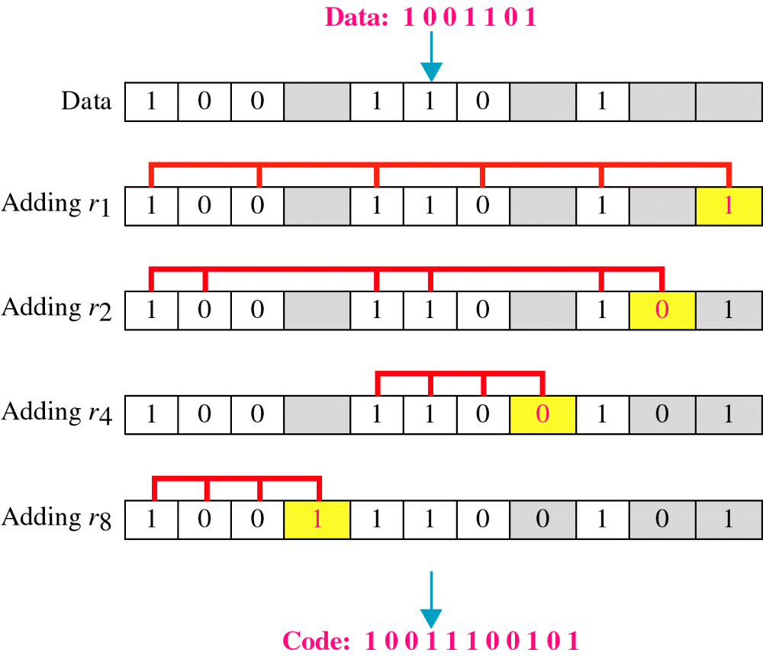
Example of Hamming Code

Slide 45
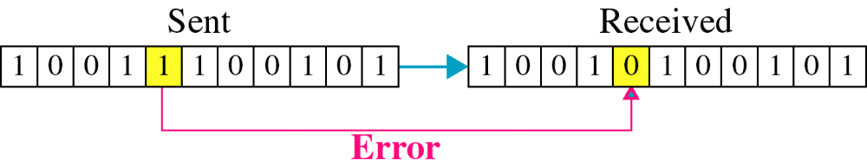
Single-bit error

Slide 46

Error
Detection

Slide 47
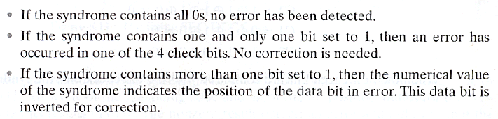
Hamming Code Syndrome Design Criteria

Slide 48
Burst Error Correction
Hamming Code cannot correct a burst error directly.
How to correct the burst Errors ?
It is possible to re-arrange the data and then apply the code (at the receiver).
Instead of sending all the bits in the data unit together, we can organize N units in a column (Longitudinal Redundancy Check).
Send the first bits of each data unit followed by the second bit of each, and so on.
In this way, if a burst Error of M bit Occurs (M<N), then the error does not corrupt M bit of single Unit, it Corrupt only 1 bit in a data unit.
Later, we can correct the single bit using Hamming Code Technique.

Slide 49
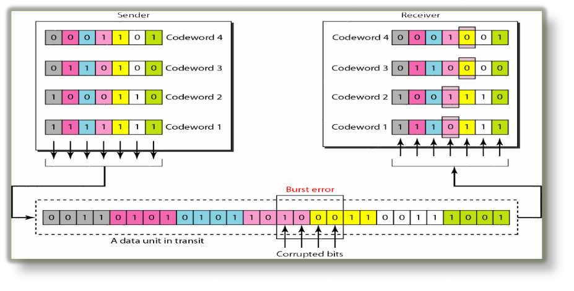
Burst Error Correction

Slide 50
Flow Control
Flow control. The sending station must not send frames at a rate faster than the receiving station can absorb them.
Technique for controlling the data transmission so that receiver has sufficient buffer space to accept data before processing. This is needed as
  Receiver buffer is limited.
  The larger the transmission, the more error (With smaller frames, error are detected sooner, smaller amount of data needs retransmission).
  On a shared medium, (LAN), it is usually desirable not to permit one station to occupy the medium for an extended period, as this causes long delay at the other sending stations.
Transmission time
  Time taken to emit all bits into medium.
Propagation time
  Time for a bit to traverse the link
Common flow control schemes:
  Stop-and-Wait
  Sliding Windows

Slide 51
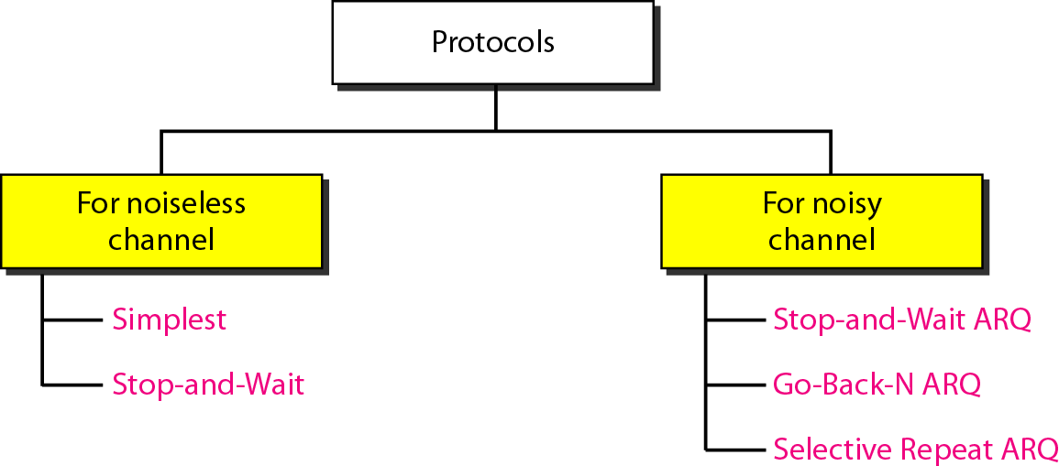
Flow Control
Two approaches are commonly used:
Feedback-based flow control, the receiver sends back information(ACK) to the sender giving it permission to send more data.
“You may send me n frames now, but after they have been sent, do not send any more until I have told you to continue”.
2. Rate-based flow control, the protocol has a built-in mechanism that limits the rate at which senders may transmit data.
Rate based flow control is not used at the DLL.

Slide 52
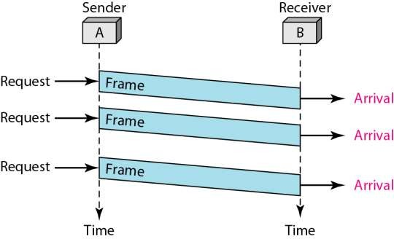
AN UNRESTRICTED SIMPLEX PROTOCOL
(Noiseless Channel)
In this protocol: Data is transmitted in one direction only.
The transmitting (Tx) and receiving (Rx) hosts are always ready.
Processing time can be ignored.
Infinite buffer space is available.
No errors occur; i.e. no damaged frames and no lost frames (perfect channel).
Unrealistic protocol.

Slide 53
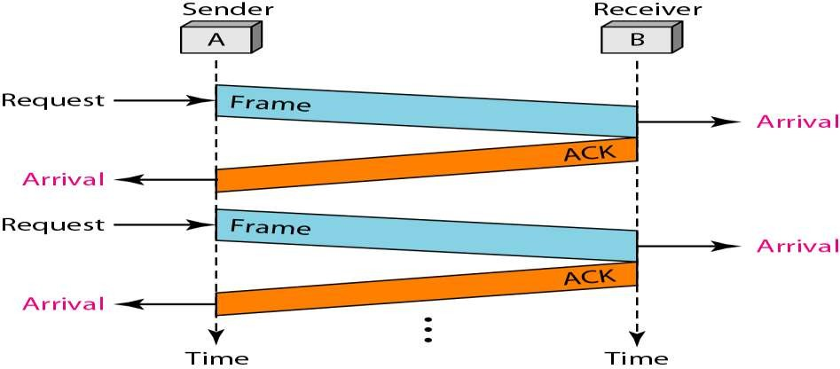
A SIMPLEX STOP-AND-WAIT PROTOCOL
(Noiseless Channel)
How can we prevent the sender from flooding the data frames to the receiver.
Protocol in which the sender sends one frame and then waits for an ACK: stop-and-wait.
No errors occur (perfect channel).
Only Lost packets(packet drops) exist.
Bi-directional information transfer.
Half duplex physical channel. 63
Unrealistic protocol.

Slide 54
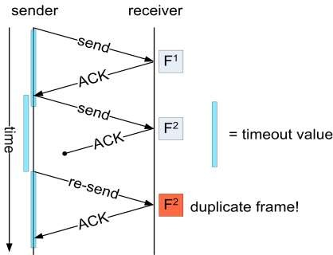
A SIMPLEX PROTOCOL FOR A NOISY CHANNEL
In this protocol, the unreal "error free" assumption in protocol 2 is dropped.
Frames may be damaged(due to noise) or lost(packet drop) completely.
Receiver sends ACK only when the frame doesn’t have damaged and lost.
Problem :
  When ACK is lost then same packet will be transmitted twice to receiver.
  How to detect the duplicate frames at the receiver ?

Slide 55
A SIMPLEX PROTOCOL FOR A NOISY CHANNEL
Sequence numbers :
  Helps to detect the redundant(duplicate) packets at the receiver.
  Each frame is associated with “1 bit” Sequence number.
  Sequence number is associated with both data frame and ACK.
  Sender will add “0 or 1” sequence number to the frame.
  Once the frame is reached to receiver without lost/damage then the frame is sent to Network layer.
  When receiver sends
    ACK1: it acknowledges data frame 0 and is expecting data frame 1.
    ACK0 : acknowledges data frame 1 and is expecting data frame 0.
    ACK sequence number always announces the sequence number of the next data frame expected.

Slide 56

A SIMPLEX PROTOCOL FOR A NOISY CHANNEL

Slide 57
A SIMPLEX PROTOCOL FOR A NOISY CHANNEL
If the receiver detects an error in the frame it discards it.
If the receiver receives an out-of-order frame ( frame 0 instead of frame 1 or vice versa), it knows that the expected frame is lost or damaged and discards the out-of-order frame and resend the previous ACK
If the sender receives an ACK with a different number than the current value of S+1, it discards it.
The sending device keeps a copy of the last frame transmitted until it receives the right acknowledgment (ACK) for the frame.
The sender starts a timer when it sends a frame. If an ACK is not received within the allocated time, the sender assumes that the frame was lost or damaged and resends it.

Slide 58
Performance of Stop-and-Wait protocol
At any time, there is one frame, the one sent and waiting to be acknowledged.
Works well when propagation time is much less than transmission time
  Once the sender finishes from transmitting the frame it will arrive in very short time to the receiver because propagation time is very small. The acknowledgement frame has very small transmission time so it will arrive quickly to the sender. As a result, the sender will not stay idle for long period of time.
  When the propagation delay is higher than transmission delay, then sender has to stay IDLE(inefficient).
To improve efficiency, multiple frames should be in transition while sender is waiting for ACK. This is implemented in sliding window algorithms.

Slide 59
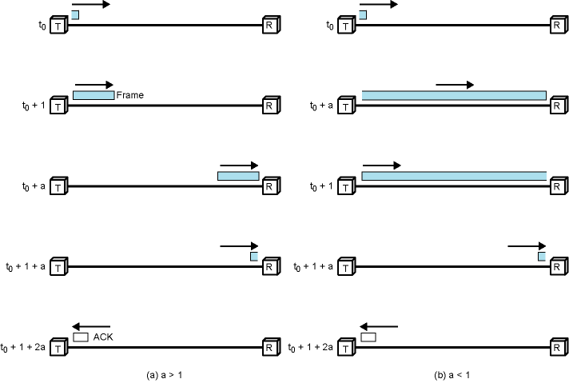
Stop and Wait Link Utilization -
Details are on the board
t₀ + T
t₀ + D
t₀ + D
t₀ + T
t₀ +T+D
t₀ +T+D
t₀ +T+2D
t₀ +T+2D
D> T
D< T
propagation time = D, transmission time = T

Slide 60
Stop-and-Wait with Bidirectional Transmission (Noisy Channel)
The previous protocol is unidirectional (data is transmitted in one direction)
For bidirectional, both nodes can send data.
To save bandwidth, data frame to be sent and control information (ACK) of the received frame are combined into one frame (Piggybacking)
If a node receive a frame and does not have data to be sent then an ACK frame is sent alone

Slide 61
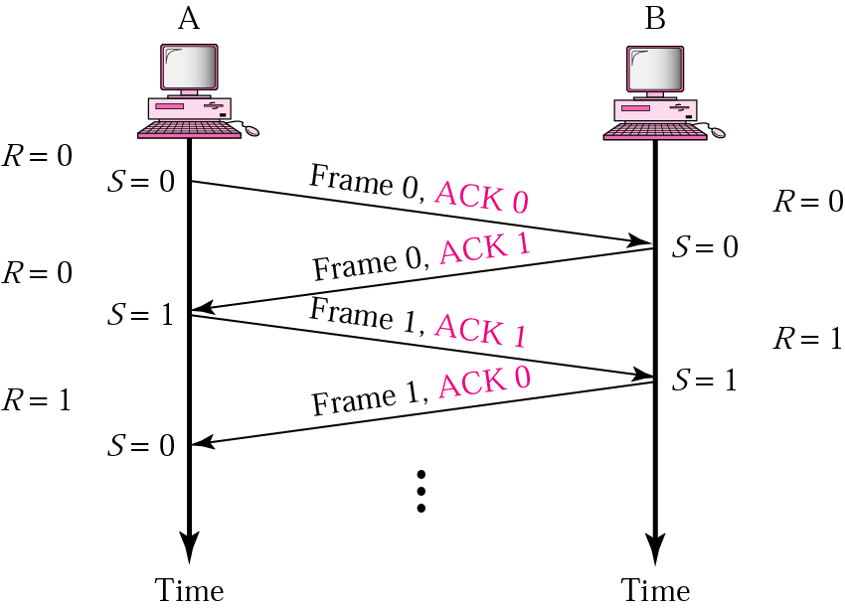
Piggybacking
A is ready to receive frame 0

Slide 62
SLIDING WINDOW PROTOCOLS

Slide 63
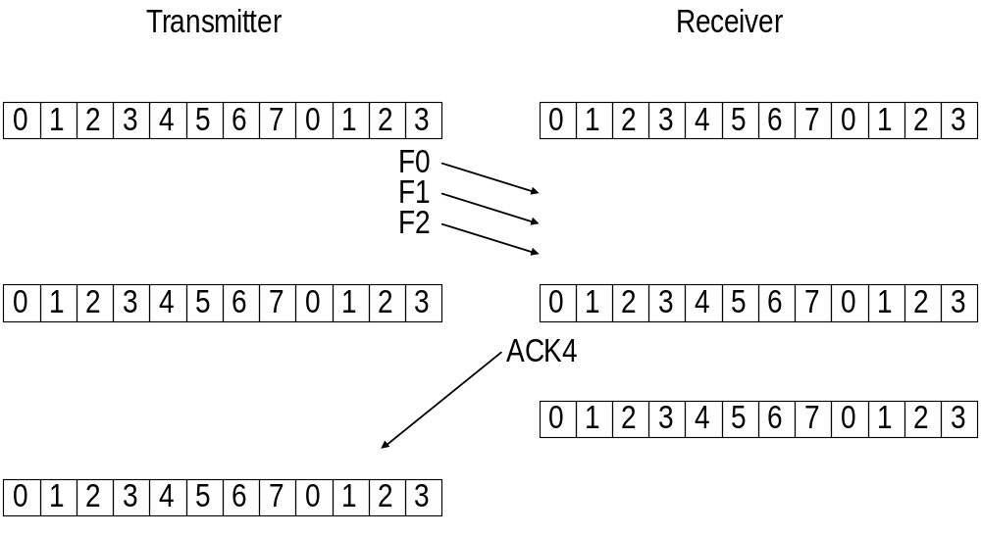
Example
3

Slide 64
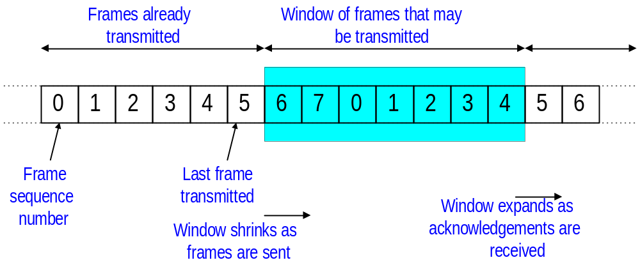
Operation of Sliding Window
Sending Window:
  At any instant, the sender is permitted to send frames with sequence numbers in a certain range (the sending window)

Slide 65
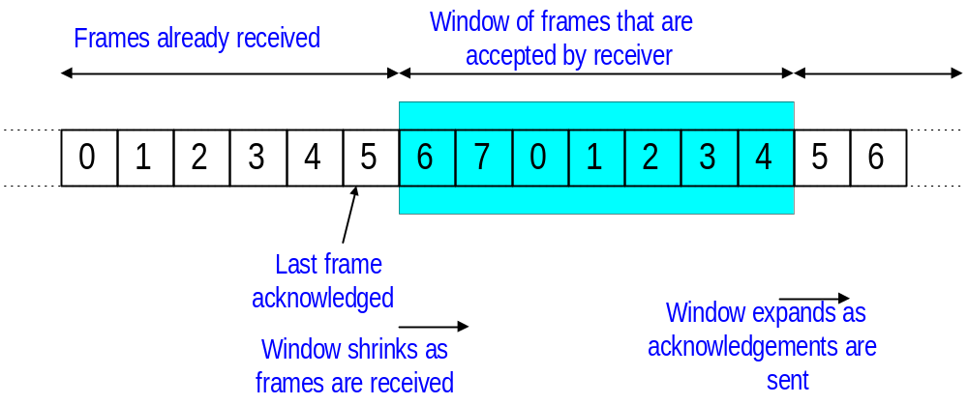
Operation of Sliding Window
Receiving Window:
  The receiver maintains a receiving window corresponding to the sequence numbers of frames that are accepted

Slide 66
Sliding Window Protocol
Setup – Sender sliding window
Frames are numbered sequentially using m-bit in the frame header
  For m bits frame sequence numbers 0 – (2^{m} –1), repeated
  m=3 ➔ (0,1,2,3,4,5,6,7,0, 1,2,3,4,5,6,7,…)
Sender can send multiple frames while waiting for ACK, but total number of unacknowledged frames should not exceed 2^{m} –1 which is called window
Window is an imaginary placeholder that covers the frames sequence numbers which can be in transit
The frames to the left of the window are already acknowledged and to the right can not be sent until window slides over them
Frames inside the window are outstanding (will be sent soon once received from upper-layer)
Sender window will slide to frame number (i ) when (ACK i) is received.

Slide 67
Sliding Window Protocol
Setup –Receiver sliding window
The receiver sends a positive ACK if a frame has arrived without error and in order (with the expected sequence number )
Receiver does not have to acknowledge each individual frame received correctly.
Receiver can send cumulative ACK for several frames (ACK 5 acknowledges frames (0,1,2,3,4) and expecting frame 5).
If the expected frame is received without errors, the receiver window slides over the next sequence number.
If the frame is damaged or out-of-order, the receiver discards it (and stay silent) and also discards all subsequent frames until it receives the one expected.
  In this case, no ACK will be transmitted
If the sender timer expires before receiving an ACK, it will resend ALL frames beginning with the one expired until the last one sent (Go-Back-N).

Slide 68
Operation of Sliding Window
How is “flow control” achieved?
  Receiver can control the size of the sending window
  By limiting the size of the sending window, data flow from sender to receiver can be limited
Interpretation of ACK N message:
  Receiver acknowledges all packets until (but not including) sequence number N

Slide 69
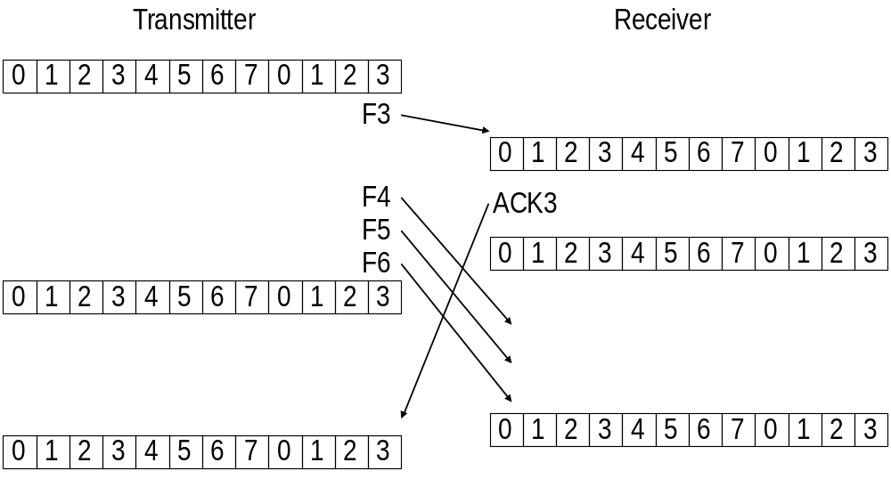
Example Continued
4
4

Slide 70
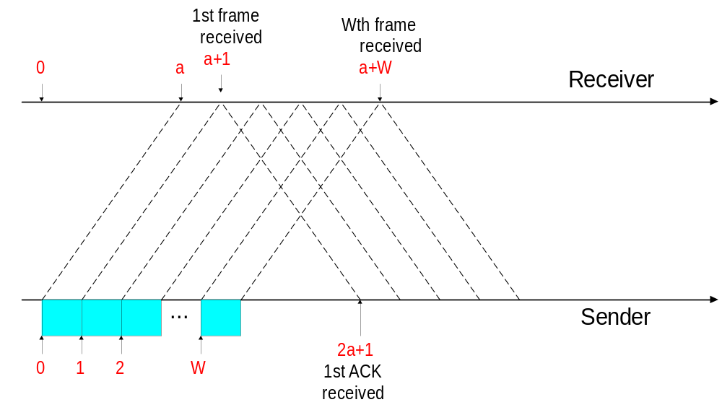
Analysis of Sliding Windows
W

Slide 71

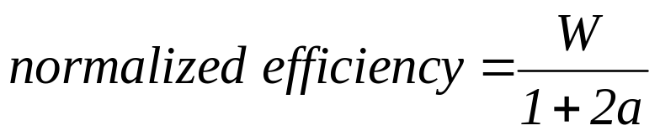
Analysis of Sliding Windows
If the window size is sufficiently large the sender can continuously transmit packets:
W ≥ 2a+1: Sender can transmit continuously
W < 2a+1: Sender can transmit W frames every 2a+1 time units

Slide 72
Error control Schemes
The most common Error control retransmission schemes:
  Go-Back-N ARQ
  Selective Repeat ARQ

Slide 73
Go-Back-N ARQ
Go-Back-N uses the sliding window flow control protocol. If no errors occur the operations are identical to Sliding Window

Slide 74
Go-Back-N ARQ
Operations:
  A station may send multiple frames as allowed by the window size.
  Receiver sends a NAK i if frame i is in error. After that, the receiver discards all incoming frames until the frame in error was correctly retransmitted
  If sender receives a NAK i it will retransmit frame i and all packets i+1, i+2,... which have been sent, but not been acknowledged

Slide 75
Go-Back-N ARQ
Lost Frame
Frames 4,5,6
are retransmitted
A
Frame 4
Frame 0
Frame 5
Frame 1
Frame 2
Frame 3
Frame 4
Frame 5
Frame 6
Frame 6
ACK 3
NAK 4
ACK 6
B
Frames 5 and 6
are discarded

Slide 76
Go-Back-N ARQ
Timeout
Lost ACK
Frames 0-4
are retransmitted
A
Frame 0
Frame 4
Frame 3
Frame 1
Frame 2
Frame 3
Frame 0
Frame 1
Frame 2
Frame 4
Frame 5
ACK 3
ACK 5
ACK 3
Frames 0- 4 are discarded
B

Slide 77
Performance of Go-Back-N protocol
Better than Stop and wait because it keeps the sender busy while waiting for acknowledgement.
This protocol can waste a lot of bandwidth if the error rate is high because it requests the sender to retransmit the frame in error and all the subsequently transmitted frames.

Slide 78
Selective-Repeat ARQ
Setup-Window size (for both sender and receiver)
  For m bit sequence number the maximum window size 2^{m}-1
Operation
  Sender in case of damaged or lost frame retransmits
    Those which are negatively acknowledged
    Those for which timer expires
  Receiver can accept out of order frames and buffer (store) them until the lost, damaged, or delayed frame arrives.
  Receiver does not acknowledge out of order frames but buffers them only.
  If the receiver receives an out-of-order, error free frame, it will send a frame called Negative Acknowledge (NAK) with the number of the frame to be retransmitted only.
  NAK improves the performance because it requests retransmission of the lost frame before the corresponding sender timer expires

Slide 79
Selective-Repeat ARQ
Lost Frame
A
only Frame 4
is retransmitted
Frame 4
Frame 5
Frame 7
Frame 0
Frame 6
Frame 1
Frame 2
Frame 3
Frame 0
Frame 4
ACK 6, NAK 4
ACK 4
ACK 7
ACK 1
ACK 5
ACK 3
ACK 0
ACK 2
ACK 1
B
Frames 5 and 6
are buffered

Slide 80
Selective-Repeat ARQ
Similar to Go-Back-N ARQ. However, the sender only retransmits frames for which a NAK is received
Advantage over Go-Back-N:
  Fewer Retransmissions.
Disadvantages:
  More complexity at sender and receiver
  Each frame must be acknowledged individually (no cumulative acknowledgements)
  Receiver may receive frames out of sequence(buffer is needed).
  Receiver must be able to reinsert the retransmitted (lost, delayed, damaged) frame in the proper sequence after it arrives.

Slide 81
Pipelining
Pipelining: beginning a task before the previous task has ended
No pipelining in Stop-And-Wait ARQ
Pipelining in Go-Back-N ARQ and Selective repeat ARQ (Several frames can be sent before we a sender receive any news about the previous frames)
Pipelining increases the efficiency because it keeps the line busy instead of waiting

